Slide 1
Convolution Neural Network (CNN)

Slide 2
What is ‘Computer Vision’?
Computer vision is a field of study focused on the problem of helping computers to see.
It aims to make computers process, analyse images and videos and extract details.
It is a multidisciplinary field that could broadly be called a subfield of artificial intelligence and machine learning.

Slide 3
Computer Vision and Image Processing
Computer vision is distinct from image processing.
Image processing is the process of creating a new image from an existing image
It is a type of digital signal processing and is not concerned with understanding the content of an image.

Slide 4
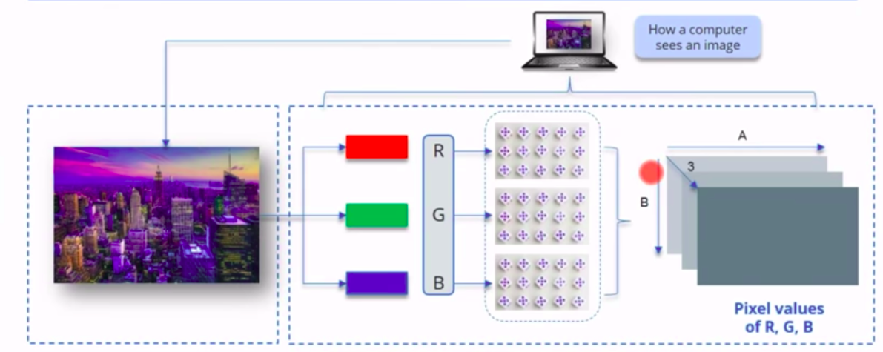
How Computer Reads an Image

Slide 5
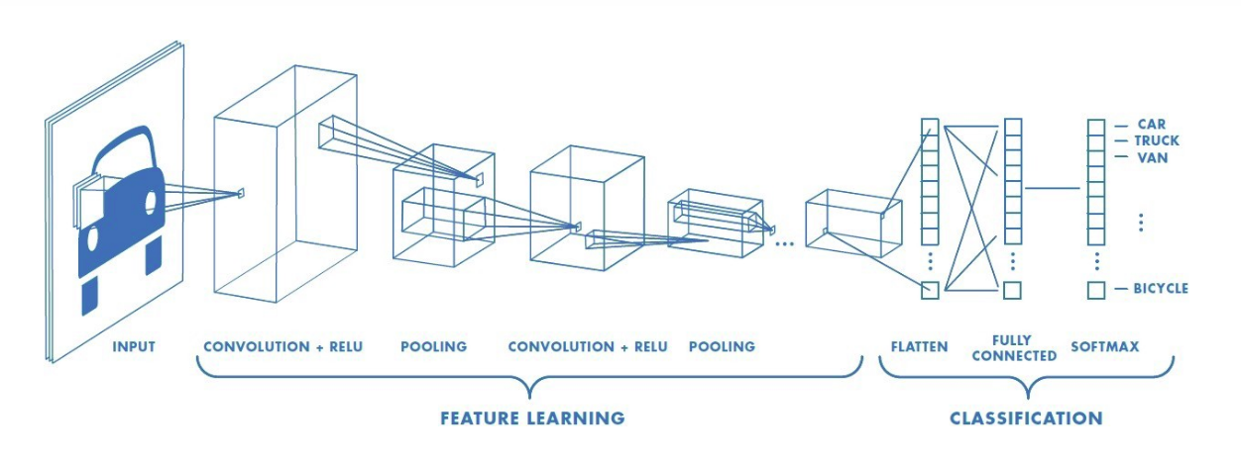
Convolutional Neural Network
Convolutional neural network (CNN, or ConvNet) is a class of deep neural networks, most commonly applied to analyzing visual imagery.
This type of neural networks is used in applications like image recognition or face recognition.

Slide 6
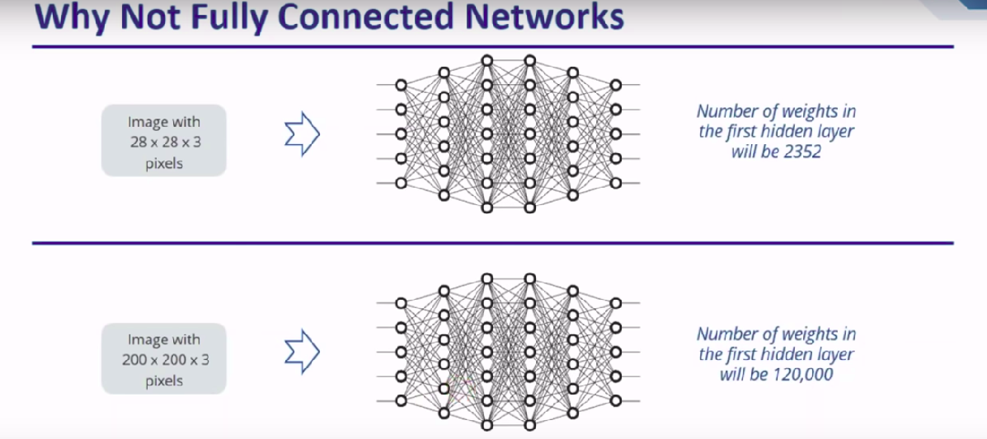
Why CNN?

Slide 7
CNN Pipeline
Convolution
Pooling
Fully Connected

Slide 8
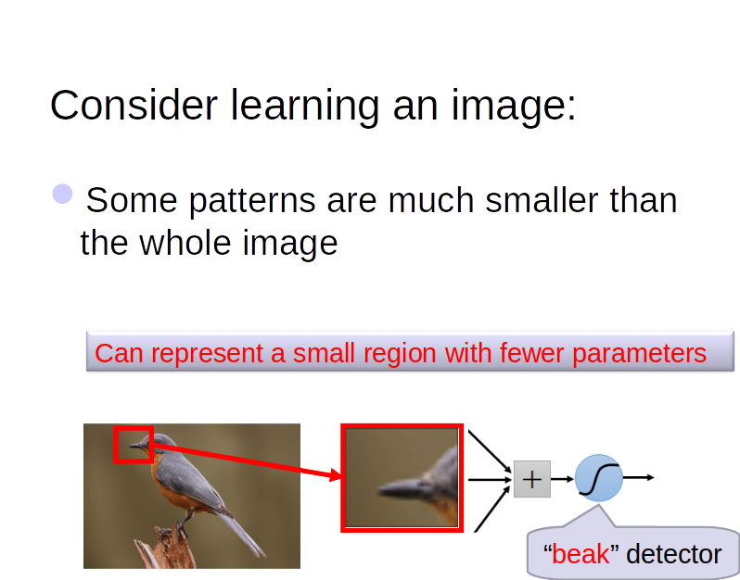

Slide 9
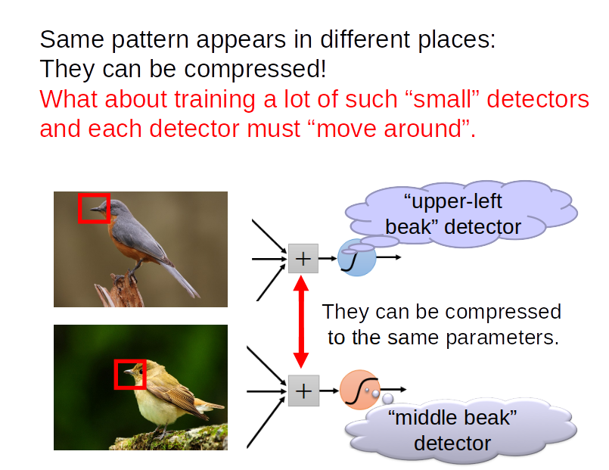

Slide 10
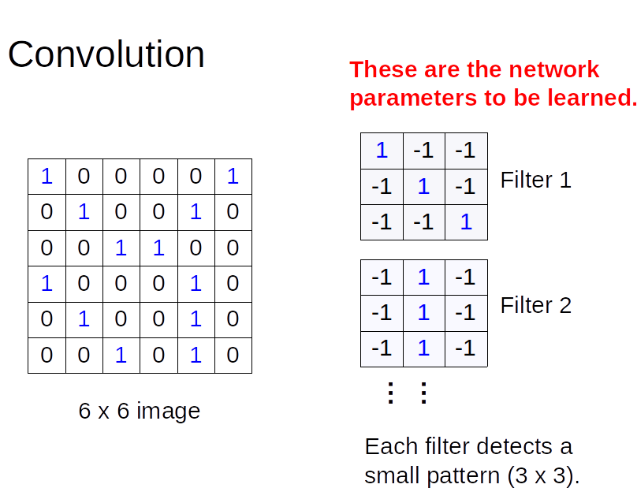

Slide 11
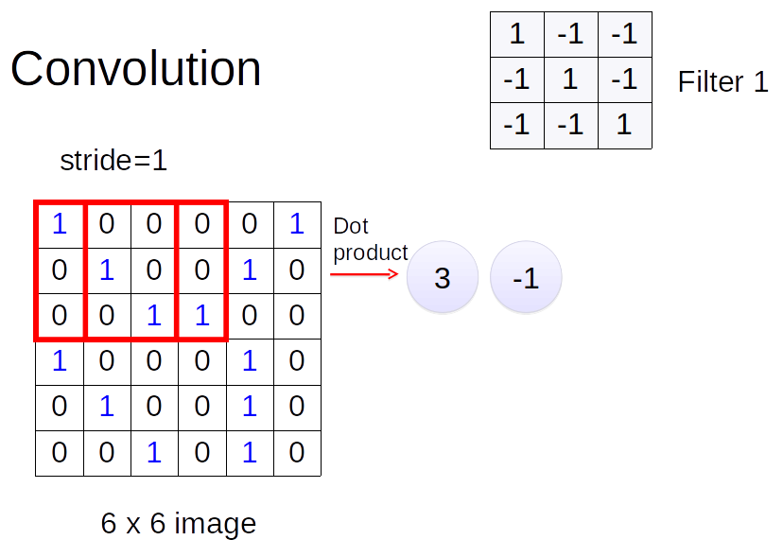

Slide 12
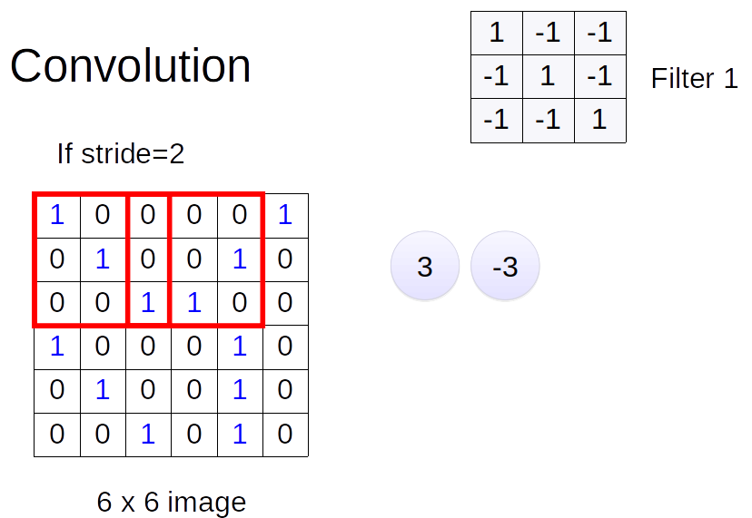

Slide 13
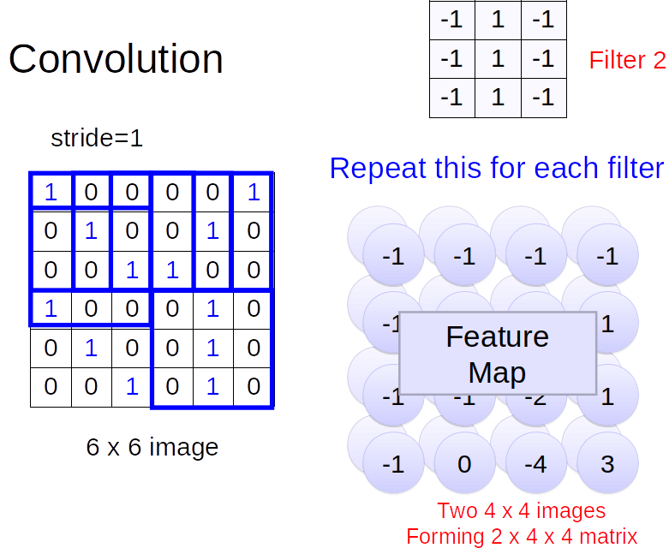

Slide 14
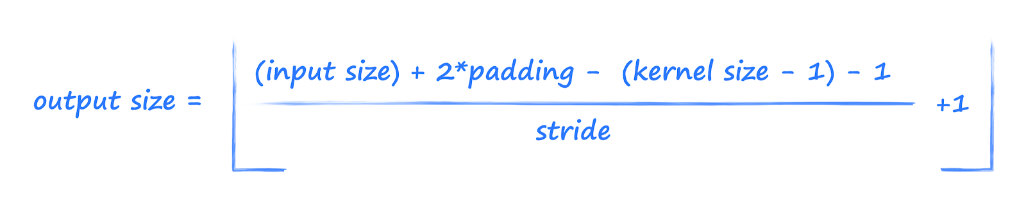

Slide 15
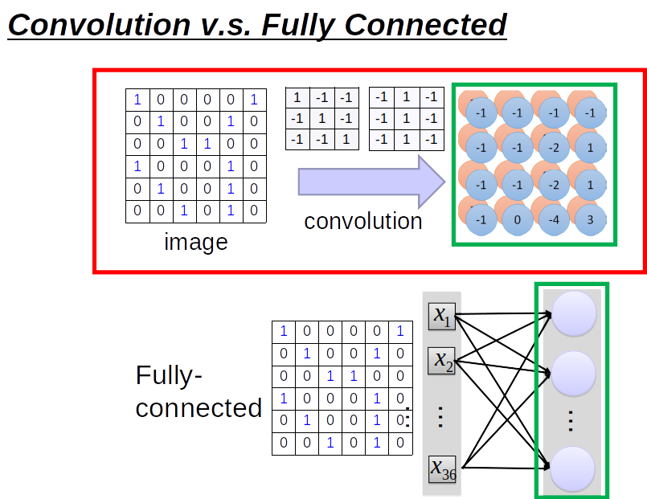

Slide 16
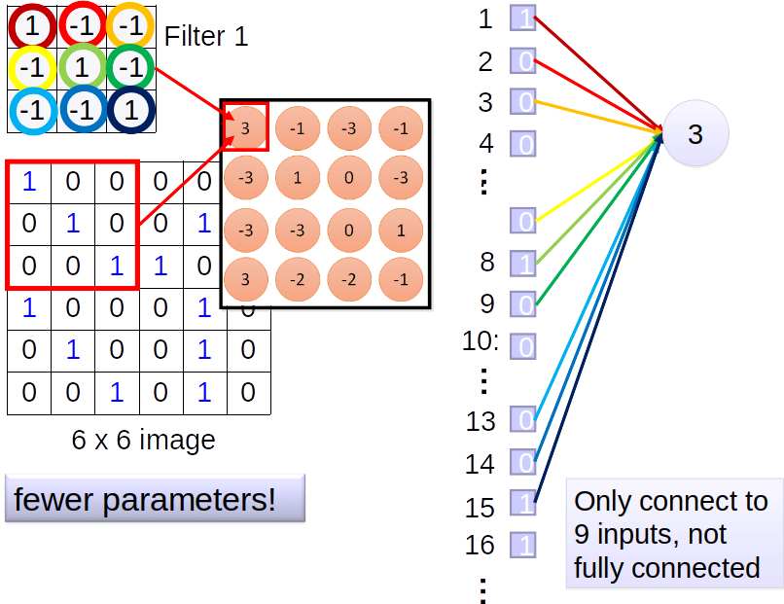

Slide 17
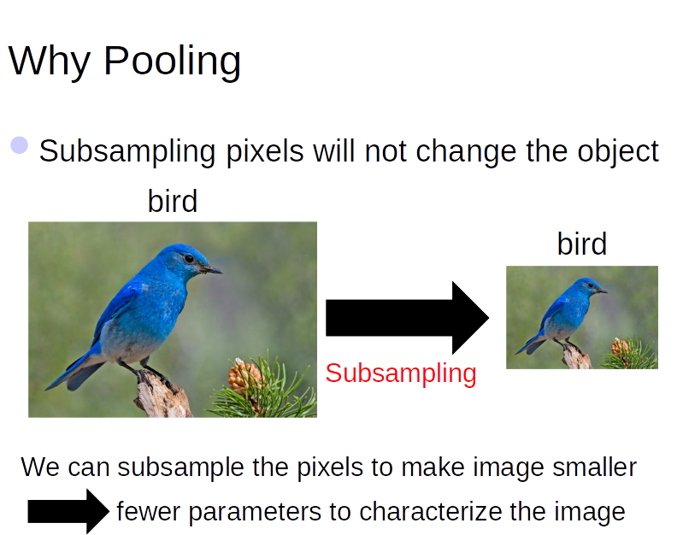

Slide 18
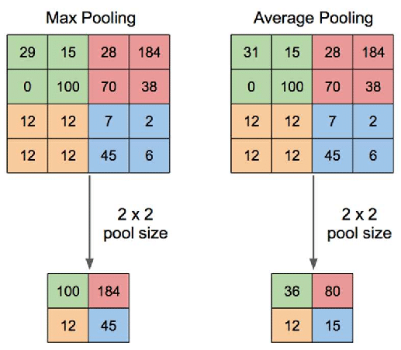
Max pooling and Average Pooling

Slide 19
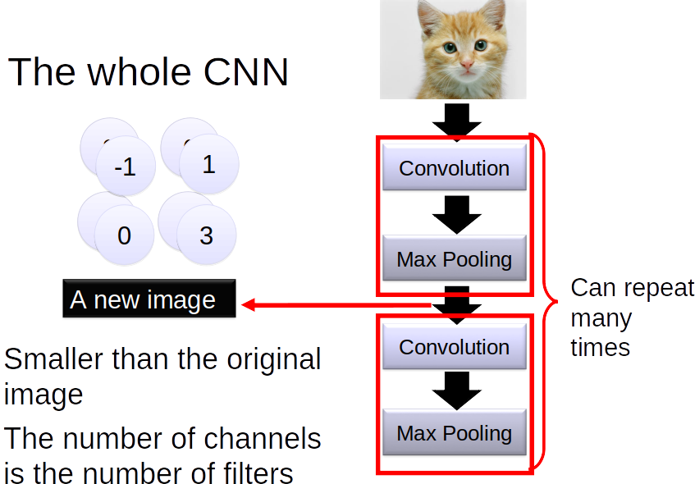

Slide 20
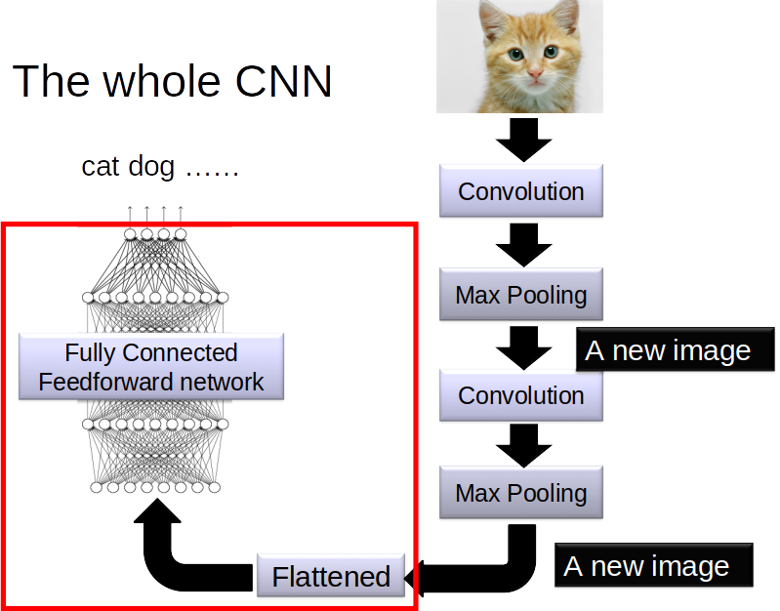

Slide 21
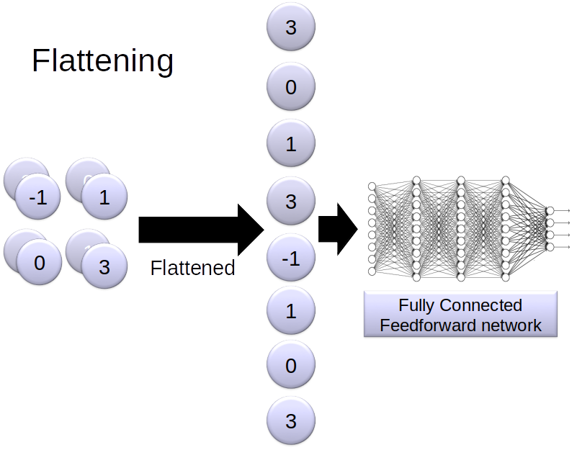

Slide 22
Final Layer
Final layer will be Softmax Layer, Sigmoid or even SVM classifier.

Slide 23
Demo
https://adamharley.com/nn_vis/

Slide 24
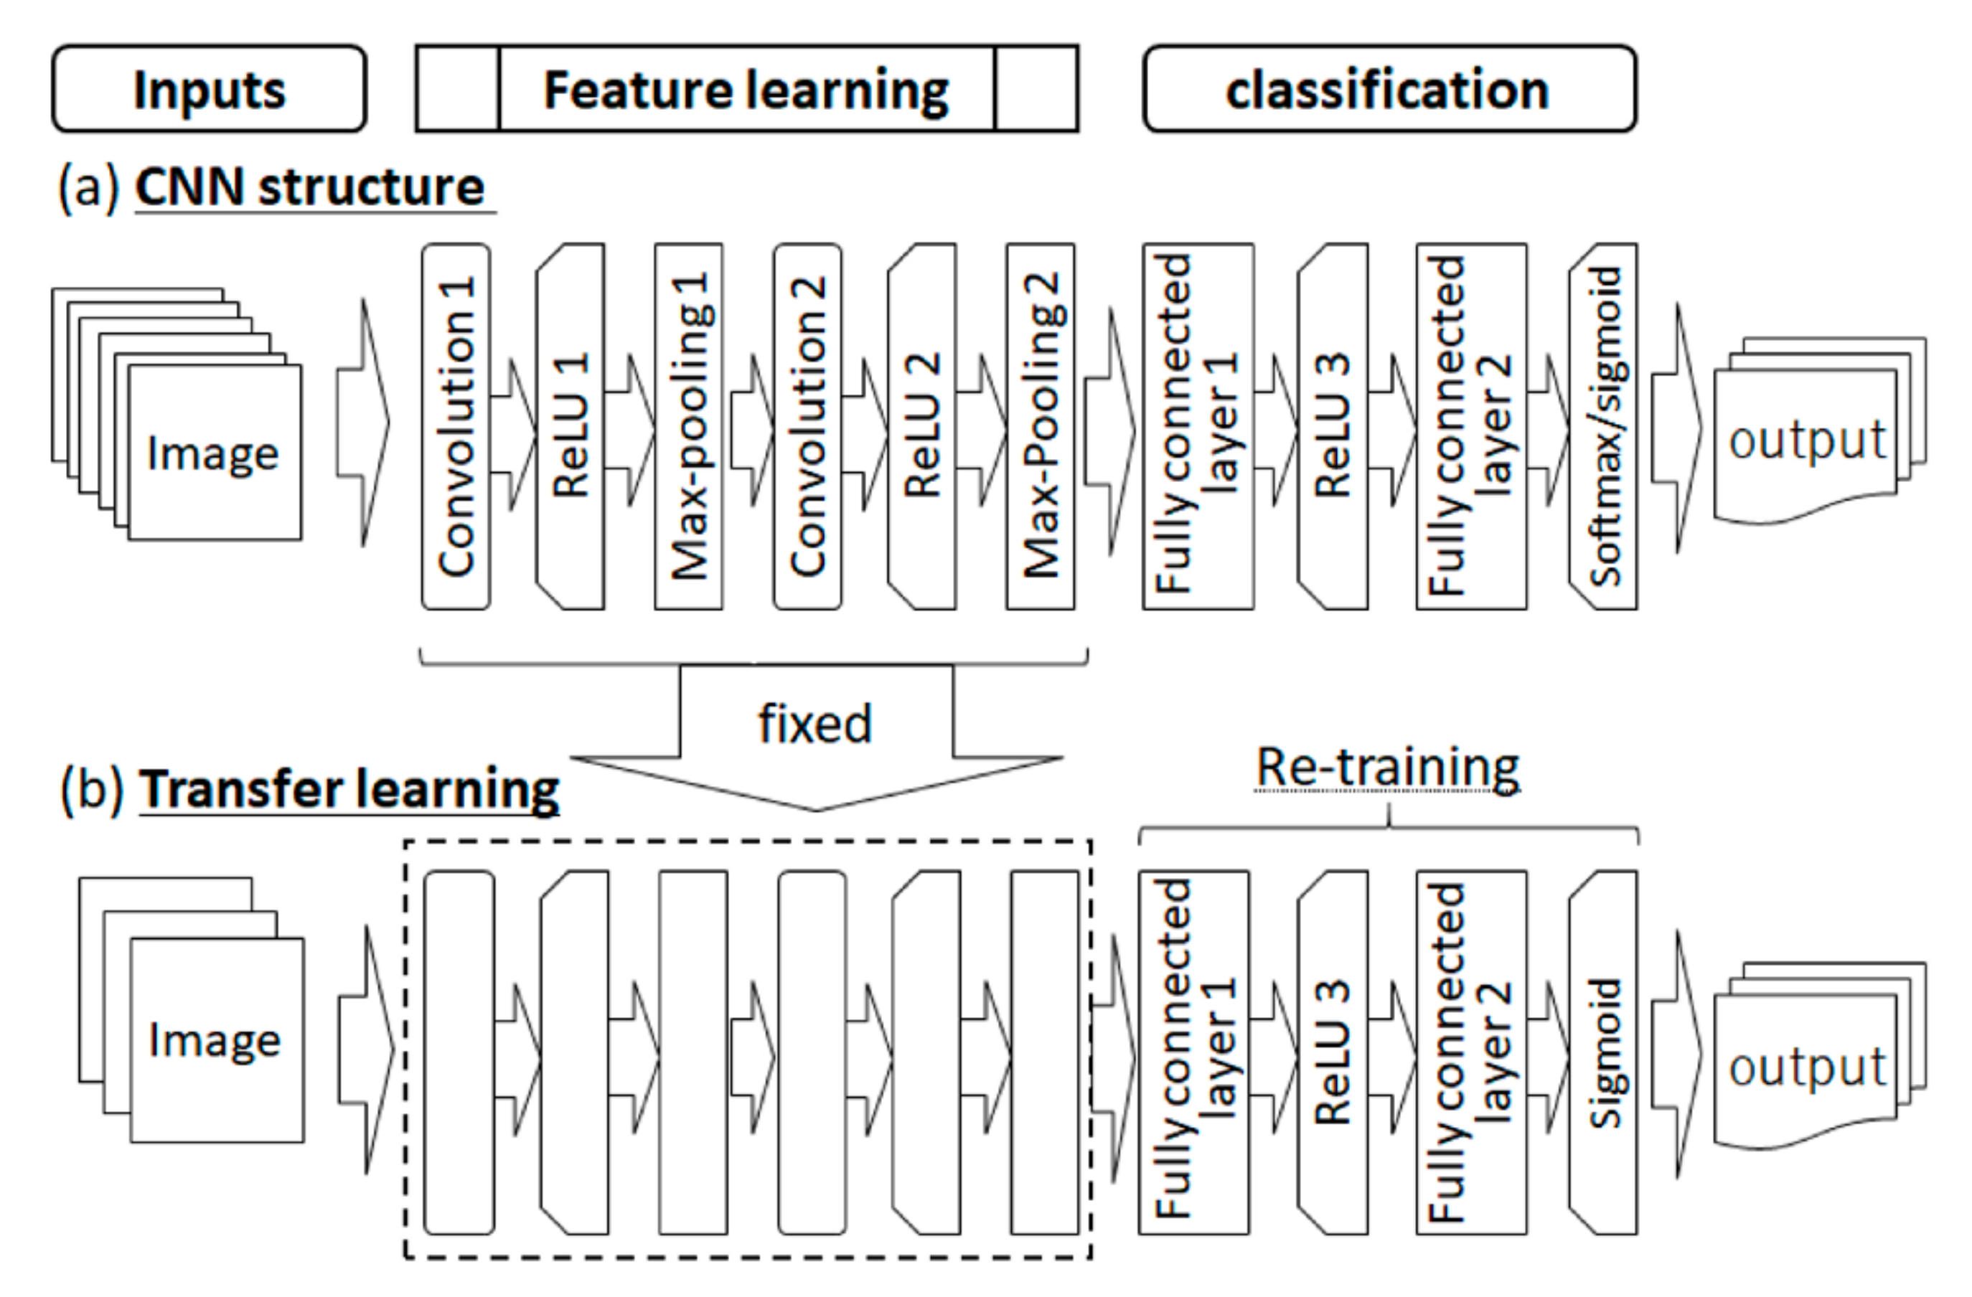
Transfer Learning

Slide 25
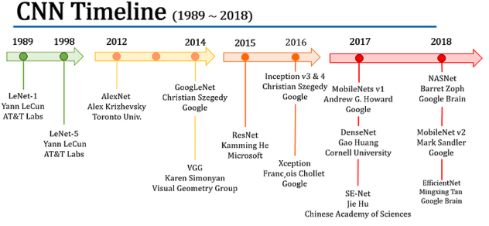

Slide 26
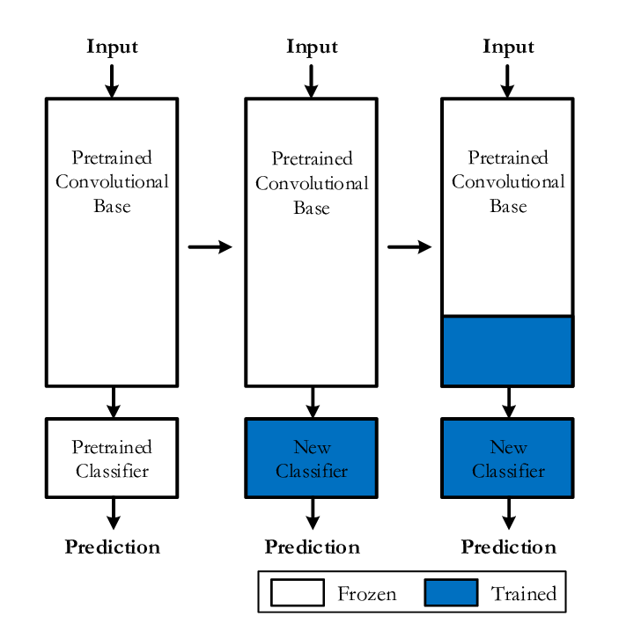
Transfer Learning

